Slide 1
Making the Most of Our Surface Storage in Los Angeles County
Presented by Chris Stone
Assistant Deputy Director
Water Resources Division

Slide 2
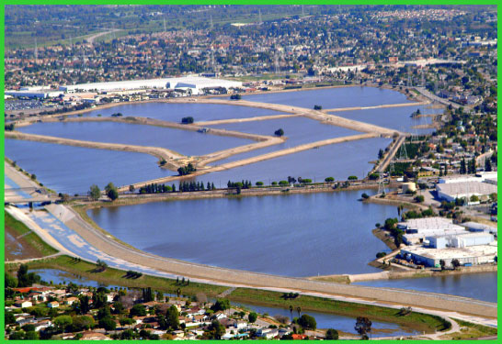
Making the most of surface storage: Storm Water Capture and Groundwater Recharge
The Flood Control District, created in 1915 by State Legislation, has a Responsibility to Manage Storm Runoff and Other Waters for Beneficial and Useful Purposes
Operates and Maintains:
14 Dams
26 Spreading Grounds
16 Rubber Dams
524 miles of major Channels
2,800 miles of tributary Storm Drains
Notes:
26 Groundwater Recharge Facilities
14 Major Dams
16 Rubber Dams
524 Miles of Major Channels
2,800 Miles of Tributary Storm Drains
“One of the Most Complex Flood Control Systems in the Nation”

Slide 3
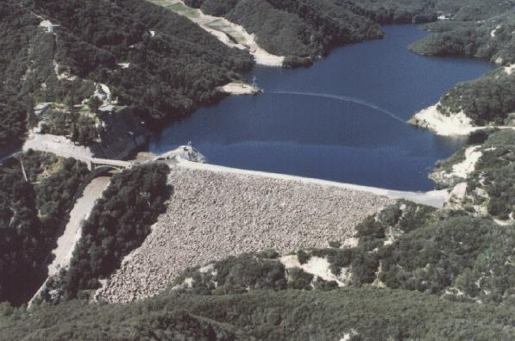
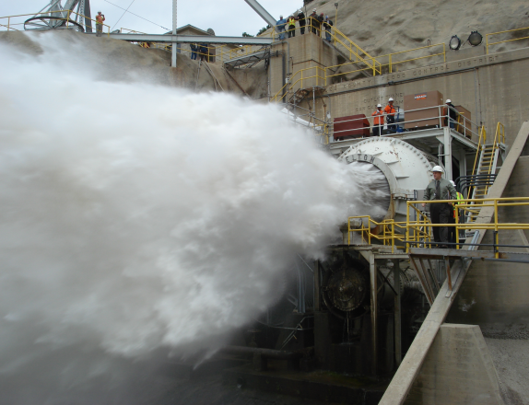
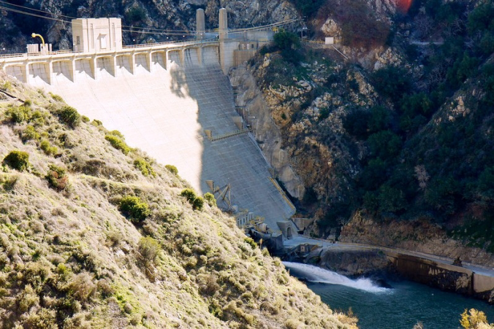
Stormwater Capture
Dam construction began in 1919 and continued through the 1930’s
During the winter months stormwater is captured at County dams and later released for groundwater recharge and water supply
Public Works operates its 14 dams year around, contributing to local water supplies even in the heat of summer
Notes:
During the Winter Months Stormwater is Captured at County Dams and Later Released for Groundwater Recharge
Public Works Operates its 14 Major Dams Year Round, Contributing to Local Water Supplies Even in the Heat of Summer
Over 114,300 Acre-Feet of Storage Capacity in the Reservoirs

Slide 4
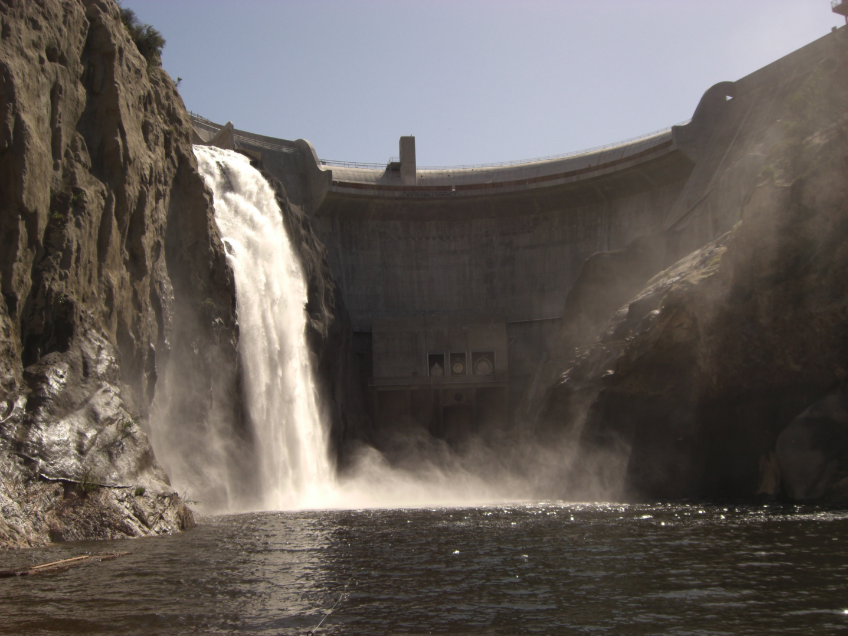
Surface storage
Surface Storage Capacity behind the Dams exceeds 114,300 Acre-Feet

Slide 5
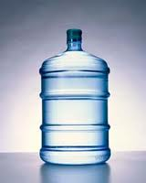
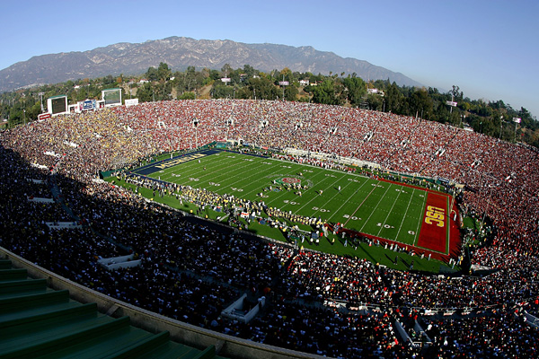
What’s and Acre-Foot of Water?
One acre-foot of water is sufficient to serve two families of four for an entire year.
One acre-foot of water would cover an entire football field approximately one-foot deep.
Notes:
One Acre-Foot of Water is Sufficient to Serve Two Families of Four for an Entire Year.
There Are 325,852 Gallons in One Acre-Foot of Water.
One Acre-Foot of Water Would Cover an Entire Football Field Approximately One-Foot Deep.

Slide 6
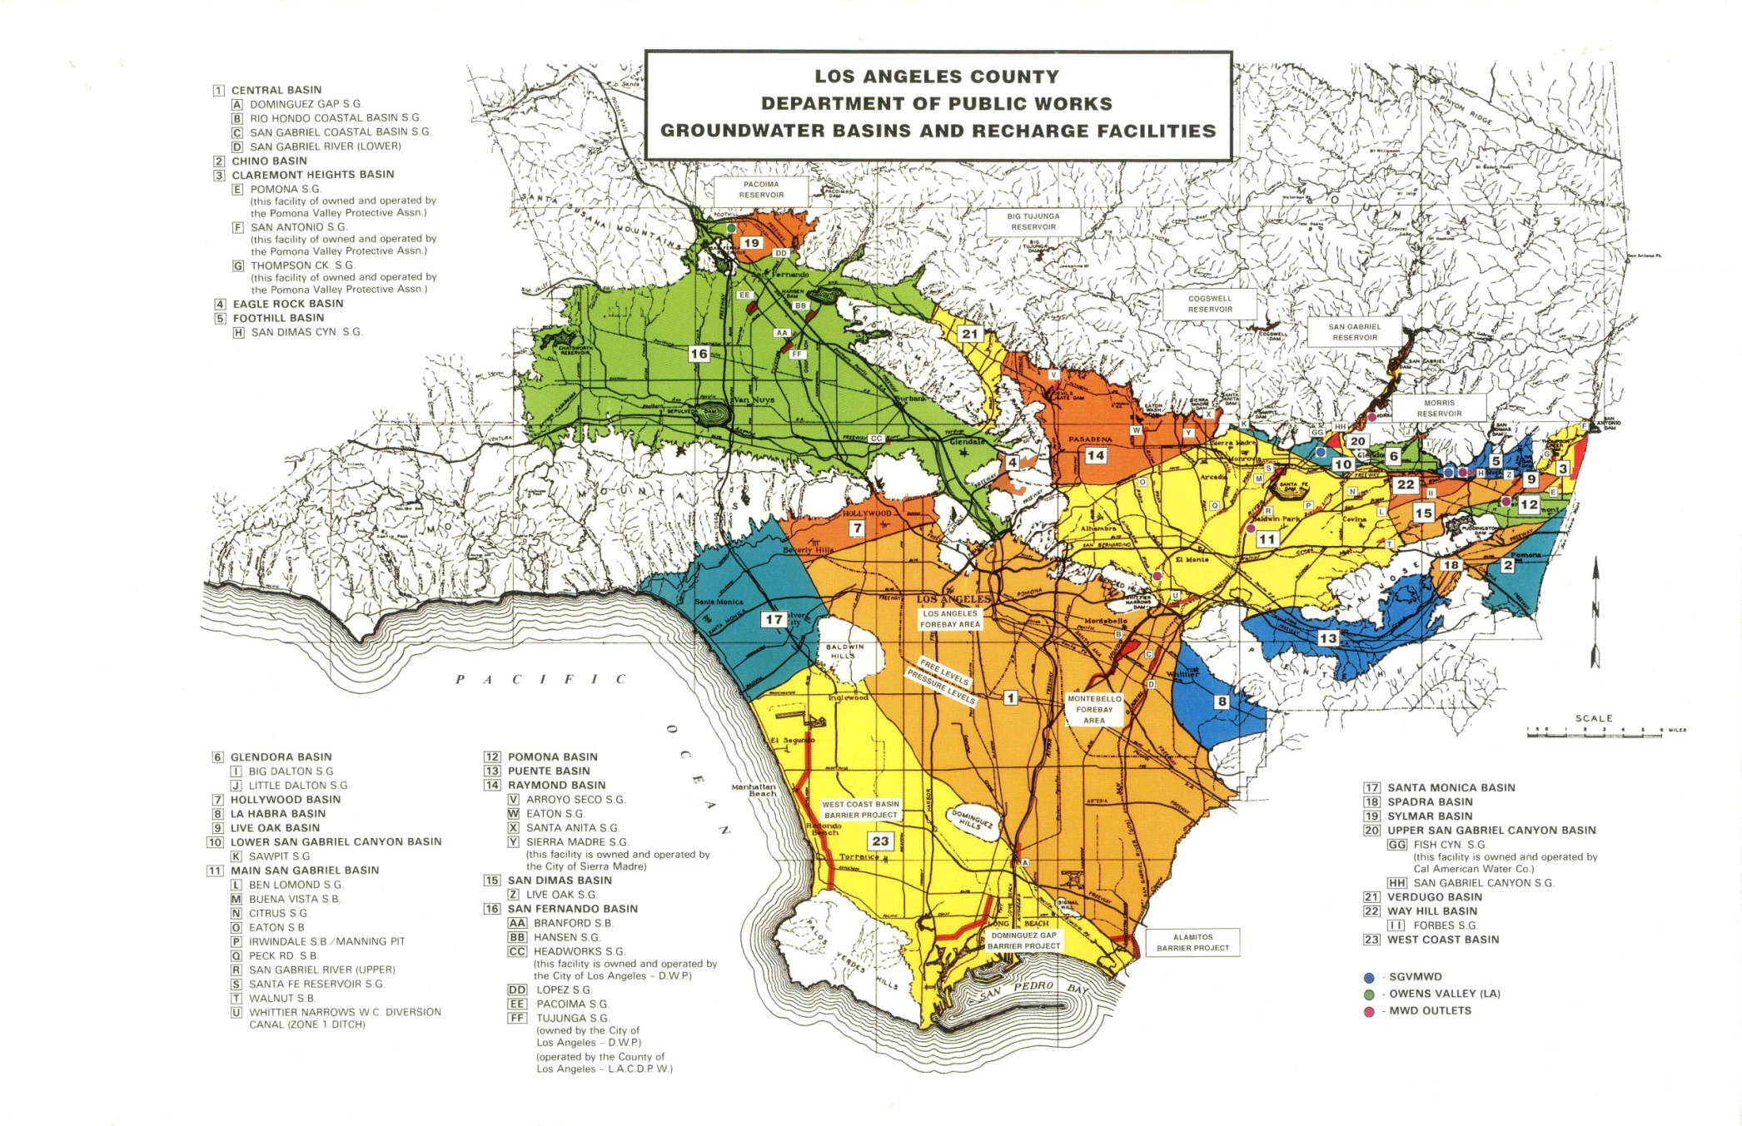
Los Angeles County Groundwater Basins
Notes:
Groundwater Basins:
The Larger Basins Are –
Central Basin (Orange)
West Coast Basin (Yellow)
San Fernando Basin (Green)
Main Basin (Yellow)
Raymond Basin (Dark Orange)
Other Basins Include –
Chino Basin
Claremont Heights Basin
Eagle Rock Basin
Foothill Basin
Glendora Basin
Hollywood Basin
La Habra Basin
Live Oak Basin
Lower San Gabriel Canyon Basin
Pomona Basin
Puente Basin
San Dimas Basin
Santa Monica Basin
Spadra Basin
Sylmar Basin
Upper San Gabriel Canyon Basin
Verdugo Basin
Way Hill Basin

Slide 7
Spreading Grounds
The first Spreading Grounds were activated in 1917
Additional facilities went into operation in the early 1930’s to the 1960’s
Water Recharged:
Stormwater
Imported water from the Colorado River and the State Water Project
Recycled water from the Sanitation Districts of Los Angeles County
Notes:
Factoids:
Rio Hondo:
Intake Capacity = 1,950 cfs
Storage Capacity = 3,694 Acre-Feet
Percolation Capacity = 650 cfs (well maintained and dry) – 250 cfs (when saturated)
Basins = 20 (10 West, 10 East)
Area = 570 acres
Sources of Water = Imported, Recycled, Storm Water
Average recharge:
Storm Water = 15,000 AF
Imported = 20,000 AF
Recycled = 30,000 AF
San Gabriel (SG / Rubber Dams):
Intake Capacity = 350 cfs / 550 cfs
Storage Capacity = 550 Acre-Feet / 1012 Acre-Feet
Percolation Capacity = 200 cfs (well maintained and dry) – 125 cfs (when saturated) / 350 cfs (well maintained and dry) – 175 cfs (when saturated)
Basins = 3 basins / 7 rubber dam reaches
Area = 128 acres / 308 acres
Sources of Water = Imported, Recycled, Storm Water
Average recharge:
Storm Water = 7,000 AF
Imported = 10,000 AF
Recycled = 15,000 AF
Average Annual Recharge in the Central Basin = 117,000 Acre-Feet
2010- 2011 Anticipated Recharge in the Central Basin = Approx. 200,000 Acre-Feet (171% of the average)
Average Annual Recharge in the Main Basin = 133,000 Acre-Feet
2010- 2011 Anticipated Recharge in the Main Basin = Approx. 330,000 Acre-Feet (248% of the average)
Average Annual Recharge in the San Fernando Basin = 25,000 Acre-Feet
2010- 2011 Anticipated Recharge in the San Fernando Basin = Approx. 93,000 Acre-Feet (372% of the average)

Slide 8
Optimizing Stormwater Capture and Groundwater Recharge
Increase and Improve:
Volume capacity
Intake capacity
Percolation capacity
Prepare for:
Long periods of storm runoff in wet seasons
Opportunities to recharge recycled water
Aquifer replenishment with imported water
Efficiency
Recently: 99% of San Gabriel River stormwater is captured
30% of Los Angeles River stormwater is captured
Notes:
To improve the ability the manage surface flows, especially in wet years we need:
Increased Volume Capacity – Sediment cleanout projects, Increased spreading grounds storage capacity, In-channel storage, etc…
Improved Intake Capacity – Spreading Ground Improvement projects to allow more diversion during periods of high flow
High Percolation Capacity – Ongoing maintenance in the spreading grounds and soft-bottom channels, removing vegetation and fine material that causes clogging
To ensure we keep the aquifers healthy, we make the most of the surface storage…
We manage our storage carefully, especially in wet years, balancing the need for flood control and stormwater capture:
In anticipation of the storm season we draw down the reservoirs over the summer to maximize our flood attenuation and storage capacity.
Facility maintenance and soft-bottom channel maintenance are performed before the storm season each year.
Spreading grounds are operated in a “Battery System” after storms to recover percolation capacity throughout the year.
Where it is permitted, recycled water is treated and recharged to supplement replenishment efforts. This is a valuable source of local water especially during dry periods.
We work with the watermaster, water districts, and other agencies to convey and recharge imported water from the State Water Project and the Colorado River…when it is available.
Efficiency:
In recent years only 1% of storm water upstream of the San Gabriel Coastal Spreading Grounds bypasses the facility. This is generally due to Flood Management and Water Quality Issues.

Slide 9
Surface Storage Surface Storage Capacity at Spreading Grounds exceeds 23,000 Acre-Feet
Public Works operates 2,436 acres of spreading grounds
1/3 of the Los Angeles County water supply comes from groundwater
Notes:
Approximately 1/3 of the Los Angeles County Water Supply Comes from Groundwater, While 2/3 are Imported from Outside Sources Such as the State Water Projects and the Colorado River. Public Works Operates 2,436 Acres of Groundwater Recharge Facilities and Soft-Bottom Channel Recharge Areas for Replenishment of Local Groundwater Supplies. Public Works Also Assists in the Operation and Maintenance of 269 Acres of Groundwater Recharge Facilities Owned by Others.

Slide 10
Groundwater Recharge
Average recharge is 280,000 acre-feet of water per year
Enough water to serve over 2.2 million people each year
Over 1,000,000 acre-feet of water recharged during the past two storm seasons
The value of this water is more than $550 million
Notes:
On average The County of Los Angeles Department of Public Works on behalf of the Flood Control District captures and recharges approximately 280,000 Acre-Feet of water per year, enough water to serve over 2.2 million people each year.
During the past two storm seasons, through strong working relationships with other agencies, proactive maintenance and operations, and a little cooperation from Mother Nature, The Flood Control District has managed to recharge over 1,000,000 Acre-Feet of water.
The dollar value of this water is more than $550 Million.
Important things to consider in order to maximize storm water capture:
Volume capacity
Intake capacity
Percolation capacity
Location
Water quality
Trained professionals managing groundwater recharge while providing flood management in the system

Slide 11
Recently Completed Projects to Improve Local Water Supply Sustainability
Valley Rubber Dams #2 and #3
Valley rubber dams increased in-channel storage: 800 acre-feet
Rio Hondo / San Gabriel Coastal Spreading Grounds Pipeline
Improved ability to maximize the recharge of stormwater, imported water and recycled water (over 7,000 af)
Hansen Spreading Grounds Facility Improvement
Increased storage capacity from 280 acre-feet to 1400 acre-feet
7,000 acre-feet additional recharge per year
Big Tujunga Dam Retrofit Project
4,500 acre-feet additional storage capacity
Notes:
To improve on groundwater recharge:
Sufficient funding for maintenance activities to maintain adequate percolation.
Proper metering and accounting for storm water captured (more gaging stations)
Improved intakes at recharge facilities to increase inflow capacity
Regular cleanouts and basin deepening at select facilities to improve volume capacity
Tighter control on discharges into the system and pollution control to ensure quality storm runoff
Additional facilities to capture runoff (more facilities are needed downstream and on the LA River Watershed)
Stress these projects were only possible due to funding partnerships
Over 1M AF of recharge, these projects may just be the reason! Let’s all send a thank you card to Ken Zimmer and make up a phony award for him. We could get a used baseball trophy and put a brass plate on it for about 10 bucks.

Slide 12
Future Projects to Improve Local Water Supply Sustainability
Tujunga Spreading Grounds Improvements
Increases storage capacity by 800 acre-feet
Increases intake capacity by 200 cfs
Pacoima Spreading Grounds Improvements
Increases storage capacity by 600 acre-feet
Devil’s Gate Dam Pump Station and Pipeline
3,000 acre-feet additional recharge per year
Reservoir Sediment Management
Over 25,000 acre-feet of storage lost to sediment
Whittier Narrows Water Conservation Pool
2,900 acre-feet additional recharge
Notes:
To improve on groundwater recharge:
Partnerships are still needed for design and construction
Increased capacity is needed for our storm patterns of fast and furious
Increased desilting is needed to increase water conservation from high storm flows while protecting the percolation rates of the facility.
How about just one more round of applause for that Zimmer guy.

Slide 13
For more information, visit: dpw.lacounty.gov/wrd/

